Slide 1

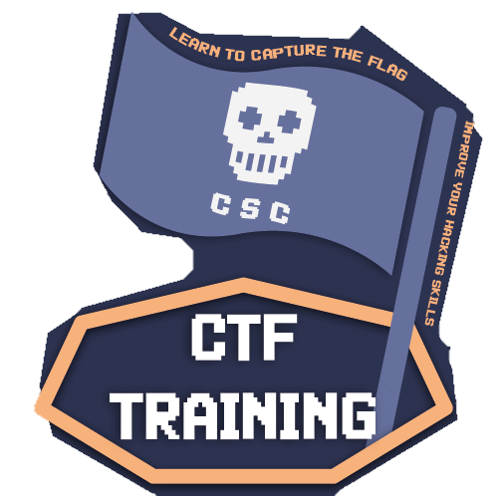

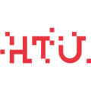

Reverse Engineering
CTF Training 2023

Slide 2

WHOAMI?
Saud Smadi [@smadi0x86]
★ President @CSCHTU
★ Offensive Cyber Security Enthusiast
★ Second Year Cyber Security Student
HOBBIES:
★ Developing & Breaking
★ Exploring Trending/New Tech

Slide 3


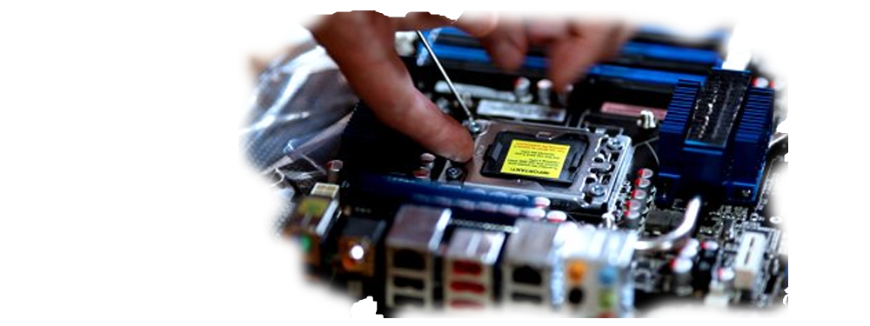
What is Reverse Engineering?
In simple terms Reverse Engineering refers to the process of deconstructing any engineered object to figure out the internal mechanisms.

Slide 4







Why Reverse Engineering?
Cracking Games/Piracy
Enhance Development Skills/Malware Analysis
Hacktivism/Open-Source Supporter
For Fun/Establish existence

Slide 5
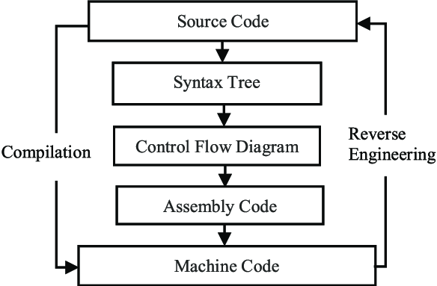








Reversing Binaries

Slide 6
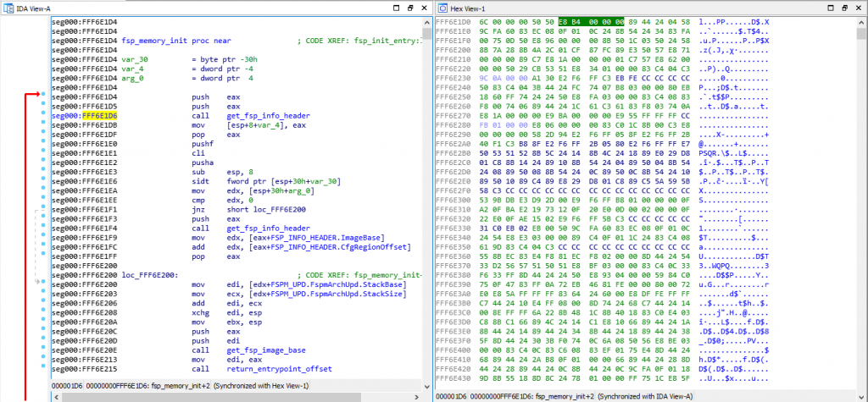
It’s not always easy
Don’t get overwhelmed

Slide 7
X86 Assembler Primer
“Everything Is Open Source If You Can Read Assembly”

Slide 8
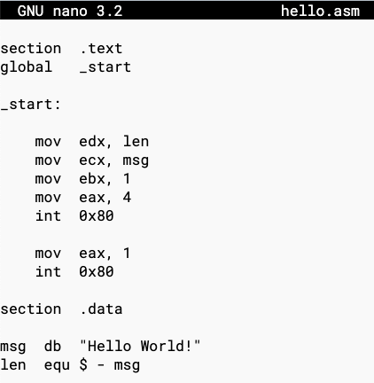




X86 ASM Intel Syntax
eax
The GNU Project used AT&T syntax, while nasm project uses intel syntax
%eax

Slide 9
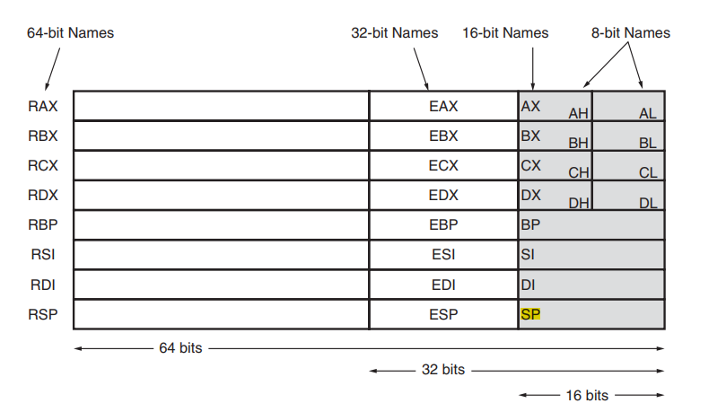
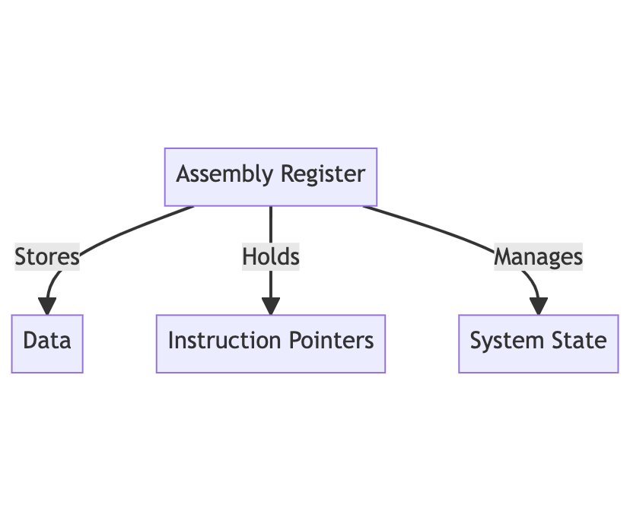

What is x86 registers?
A register can be thought of as a special memory location in the CPU.

Slide 10

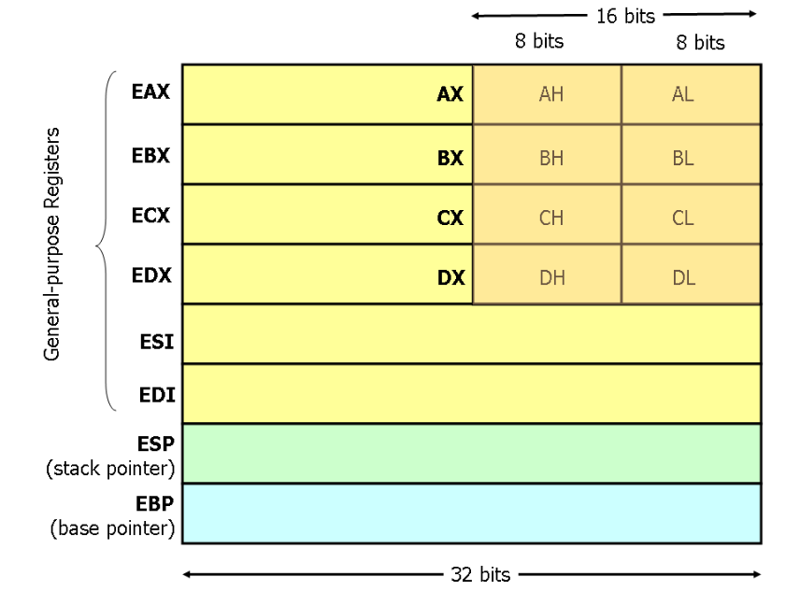
General Purpose Registers & Instructions
We can do all possible assembly operations on registers like adding values, subtracting etc.
Note that you generally don’t need to know details, just basic knowledge so you can understand logic.

Slide 11
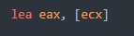
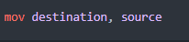
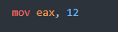
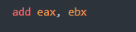
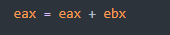
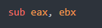
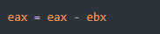
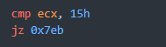
Basic ASM Operations
lea: This is like mov but instead of copying the value it copies the address.
mov operation: moves values (or assigns values)
add/sub operation: Adds or subtracts values
cmp operation: This is a very useful operation and is used for comparing values. It acts as an if statement, if the compare returns 0 it means they are equal and then we jump to 0x7eb address (jz = jump if zero)

Slide 12
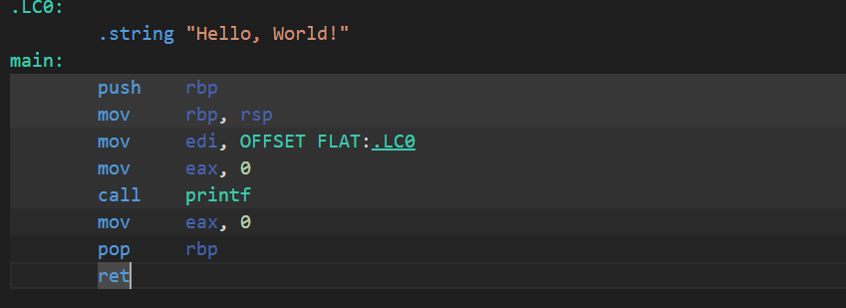
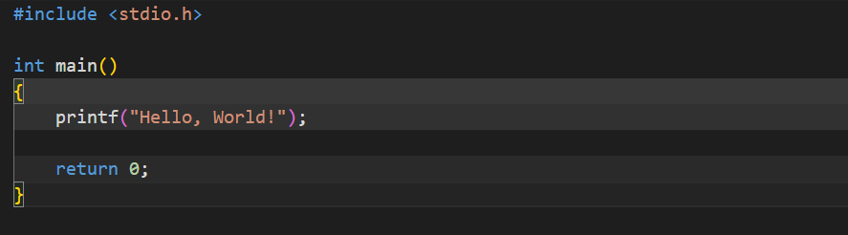
C Language vs x86 Assembly
https://godbolt.org/
Most of the time, there are a lot of initialization useless instructions that won’t be useful for us. What we are interested in is the “call” instruction which shows logic.

Slide 13
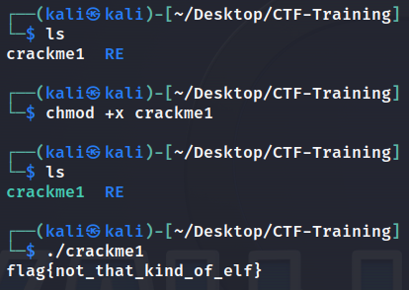

Handling Reverse Engineering Challenges
So, you downloaded the binary file, the question begins here, what’s next?
chmod +x command: Makes files able to run
file command: Gives information about file

Slide 14
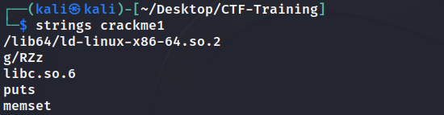
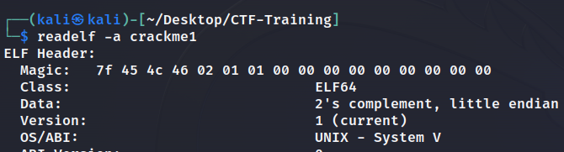
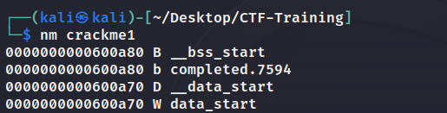
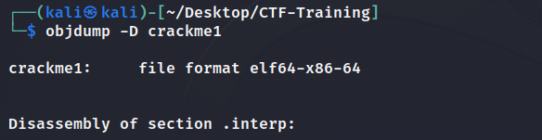
Static Analysis Of Binaries
strings: Extracts human-readable text from files
readelf: Examine elf file strucuture
objdump: Disassemble files
nm: Lists symbols in files

Slide 15
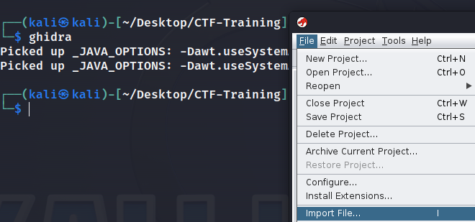

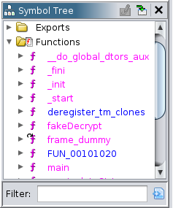
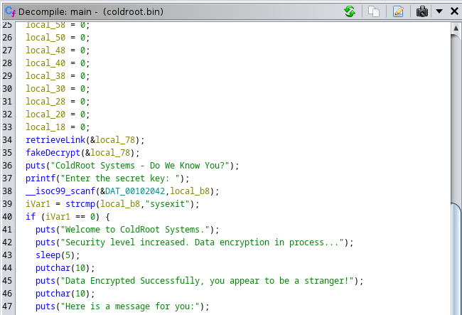
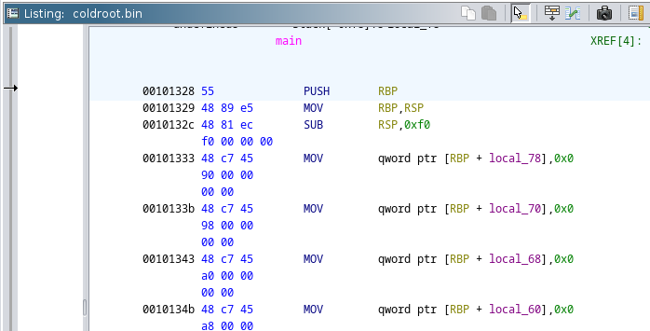
Static Analysis Of Binaries
ghidra: Reverse engineering tool that disassemble, decompile and provide useful insights

Slide 16
Dynamic Analysis Of Binaries
Did static analysis and got nothing? Maybe running/debugging the binary will reveal hidden stuff!
The most common tools for dynamic analysis are:
GDB: Debugger for analyzing
ltrace: Traces Library Function Calls
strace: Traces system calls

Slide 17
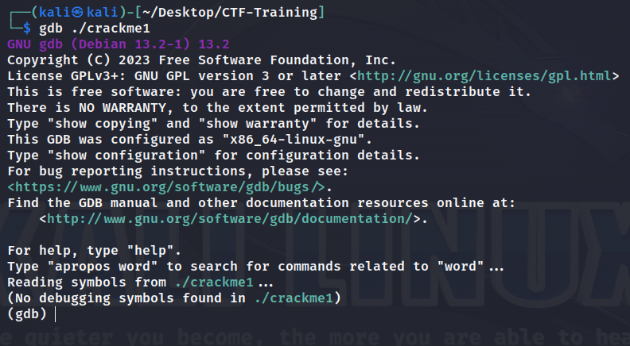
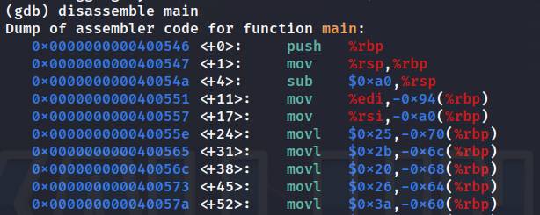
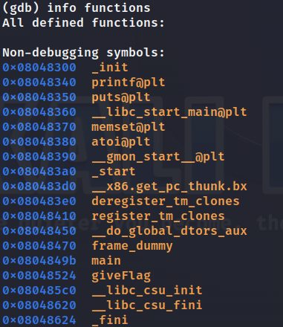
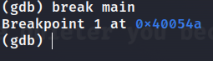
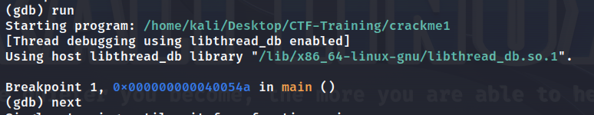
Dynamic Analysis: GNU Debugger
Run GDB:
Disassemble function:
Show Functions:
Break/Next Run:

Slide 18
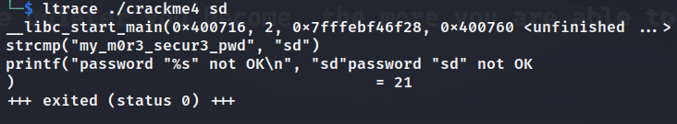
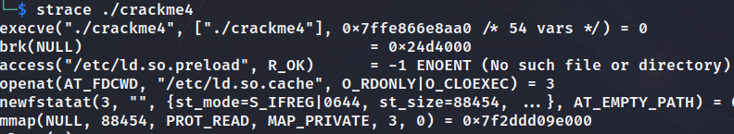
Dynamic Analysis: Ltrace & Strace
When you run strings command, you might see a “strcmp” library function, which mainly compares real flag/password with your input.
Strace:
Ltrace:
Note: Before using gdb/ghidra, its worth doing these checks to find any hints.

Slide 19
Any Questions?

Slide 20

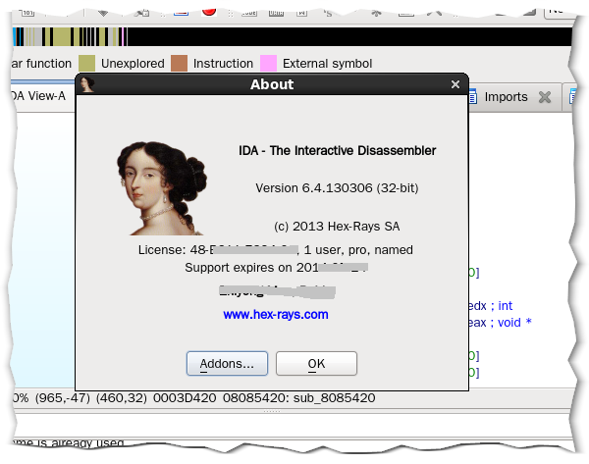
Lab 101: ColdRoot
https://github.com/Cyber-Security-Club-HTU/CTF-Training/tree/main/2023/Reverse-Engineering/Lab

Slide 21

